Slide 1
HR Analytics for Banking Sector
Roshitha HR Analyst Project

Slide 2
Project Objective
Analyze employee data
Identify attrition patterns
Build a flight risk model
Provide HR recommendations

Slide 3
Dataset Overview
Dataset: IBM HR Analytics
Total Employees: 130
Key fields: Salary, Tenure, Attrition, Performance

Slide 4
Data Preparation
Cleaned dataset
Removed unnecessary columns
Converted to banking dataset
Added new fields (Location, Risk Score)

Slide 5
Key Metrics
Attrition Rate
Total Employees: 129
Average Salary
Employees Left: 23
Attrition Rate: 17.8%
(23 ÷ 129 × 100)
Overall Average Salary: ₹6,292

Slide 6
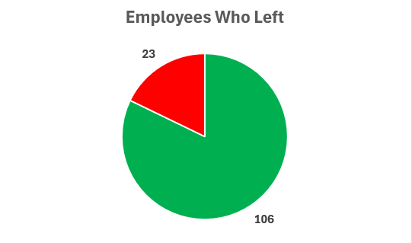
Attrition Analysis

Slide 7
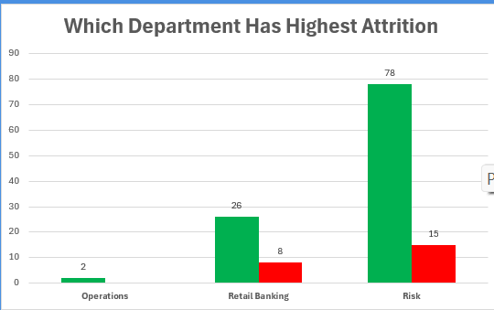
Department Analysis

Slide 8
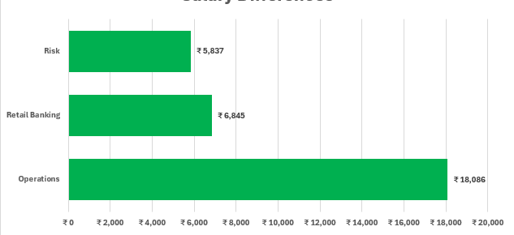
Salary Analysis

Slide 9
Flight Risk Model
Predicts employees likely to leave
Based on:
Salary
Tenure
Performance
Overtime

Slide 10
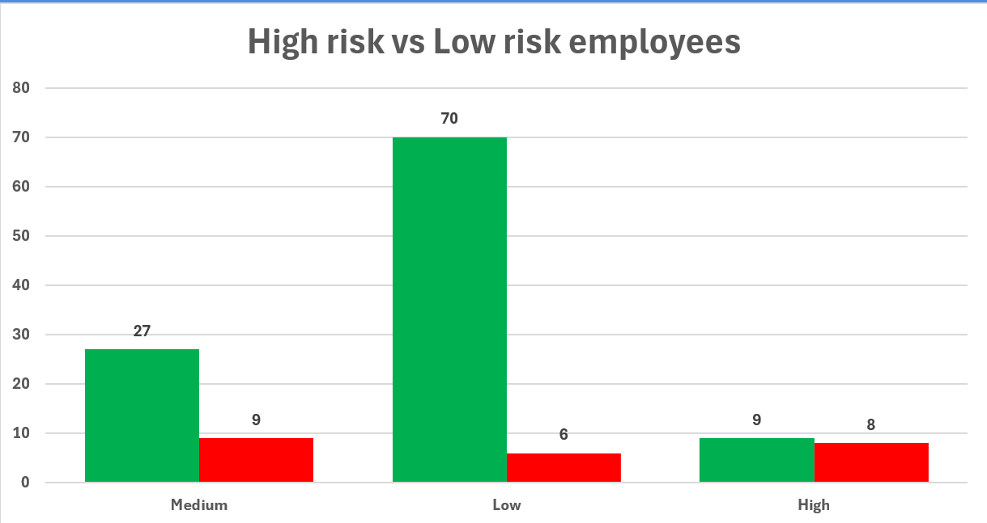
Risk Analysis

Slide 11
Insights
1. High-risk employees show higher attrition, proving the risk model is effective.
2. Departments with lower salaries have higher employee turnover.
3. Employees working overtime are more likely to leave, indicating burnout risk.

Slide 12

Recommendations
1. Increase salary for underpaid employees to reduce attrition.
2. Reduce overtime workload to improve work-life balance.
3. Focus retention strategies on high-risk employees.

Slide 13
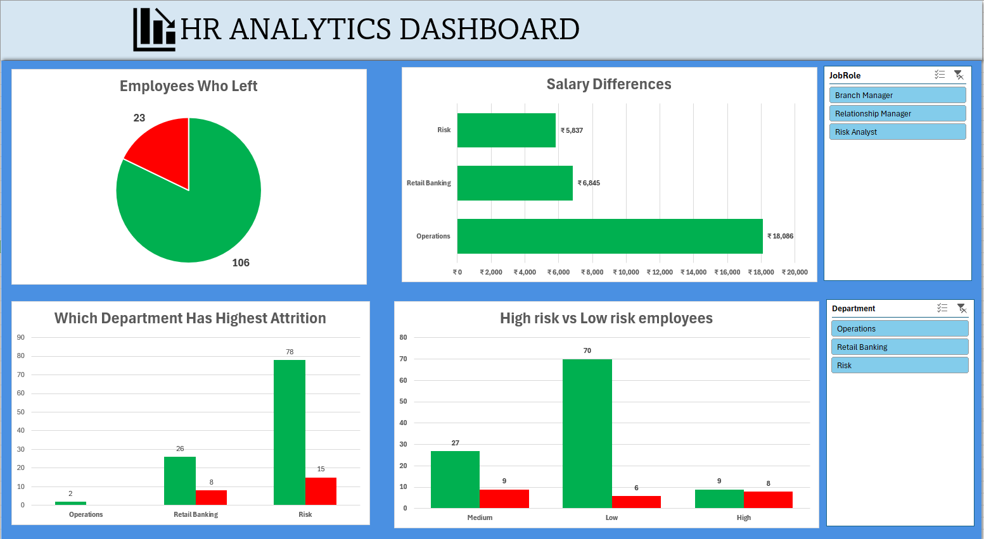
Dashboard

Slide 14

Conclusion
Data helps improve HR decisions
Reduces attrition
Improves employee performance

Slide 15
Thank you

